Slide 1
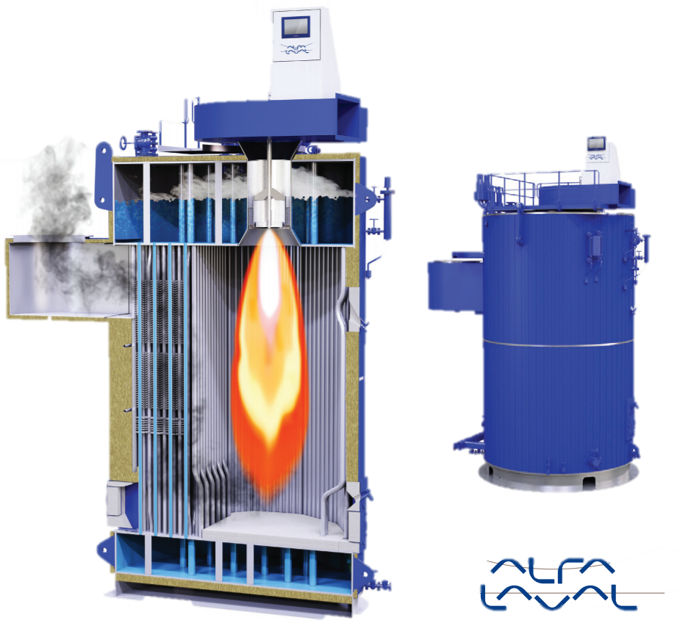
Fault detection in marine boilers
Gruppe 935
Ignacio Trojaola bolinaga, jesper Hove Jørgensen
and Jonas Ørndrup nielsen

Slide 2
Agenda
Jesper:
Introduction & project description
System description
Typical faults
Fault analysis example
Jonas:
Fault detection concept
Modelling
Closed loop identification with Hansen Scheme
Ignacio:
Closed loop identification with grey box estimation
Fault detection design
Conclusion and future work

Slide 3
Introduction
Alfa Laval Aalborg is the world leader in marine boilers for tankers
Every second tanker or carrier has an Alfa Laval boiler
Boilers are crucial for the vessels
Heating of heavy fuel oil
Charge and discharge of cargo
Steam is used for e.g. heating, cleaning, hot water
Breakdowns are costly
Non-operational vessel
Fines up to 100k USD a day
Reliability and availability of the boilers are essential
Fault detection

Slide 4
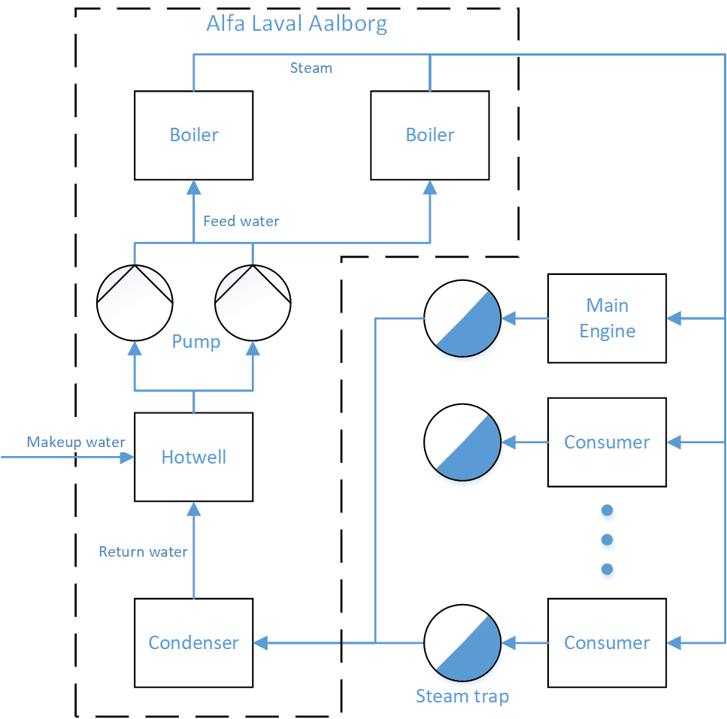
The marine boiler system

Slide 5
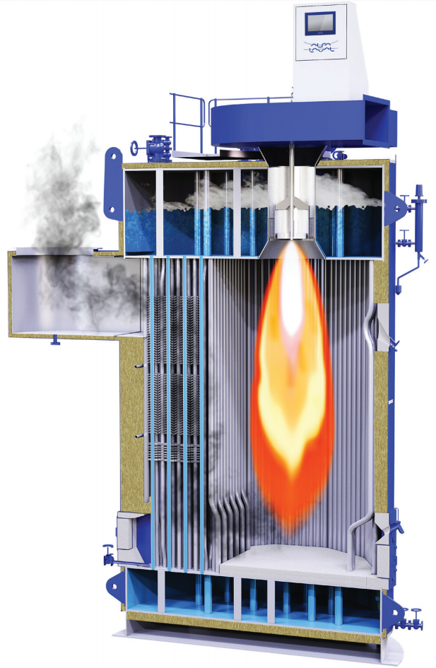
The OL boiler setup
The 20-25 tons/hour OL boiler is the most used in tankers and cargo vessels
Two drum setup with natural circulation
Convectional and radiational energy transfer from top fired burner

Slide 6
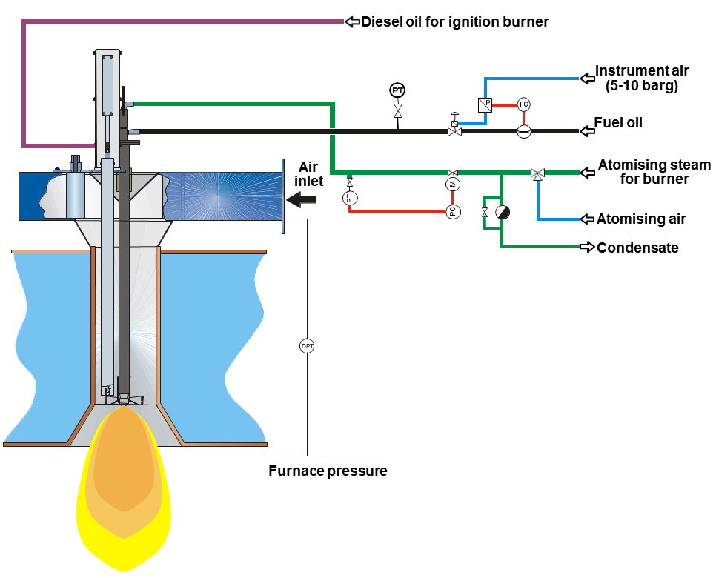
Control loops in the OL boiler
The load is set by the outer control loop based on the steam pressure
The air and oil flow reference to inner loops is look-up based on boiler load
Fuel oil are pressure and temperature controlled
Water level control from constant running pump

Slide 7
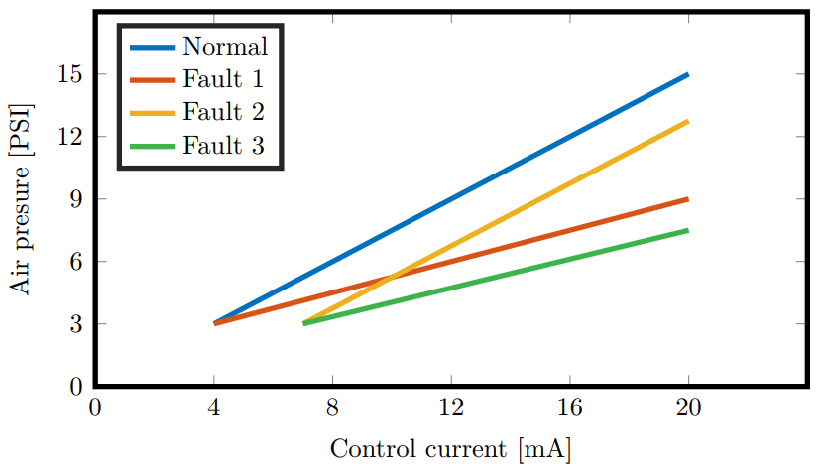
Typical faults in the OL boiler
I/P converter faults
Air flow actuator
Oil flow actuator
Feed water actuator
Faulty oil flow and air flow sensor
Wrong AFR
Combustion problems
Soot build up
Descreased convection
Can block up causing combustion problems
Isolating oil layer
Decreased convection
Red-hot metal
Deformation
Weakning of structure
Leaks in pressure part
Bad water quality
Rain in funnel
Incorrect flame adjustment
Burned away refractory layer
Combustion or steam pressure problems

Slide 8
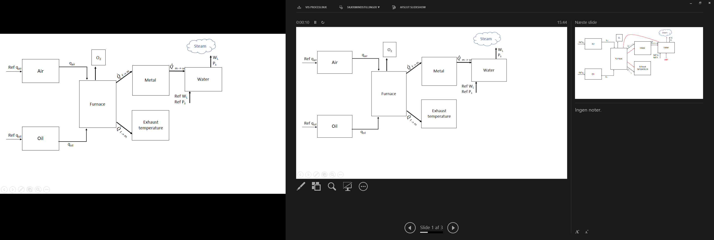
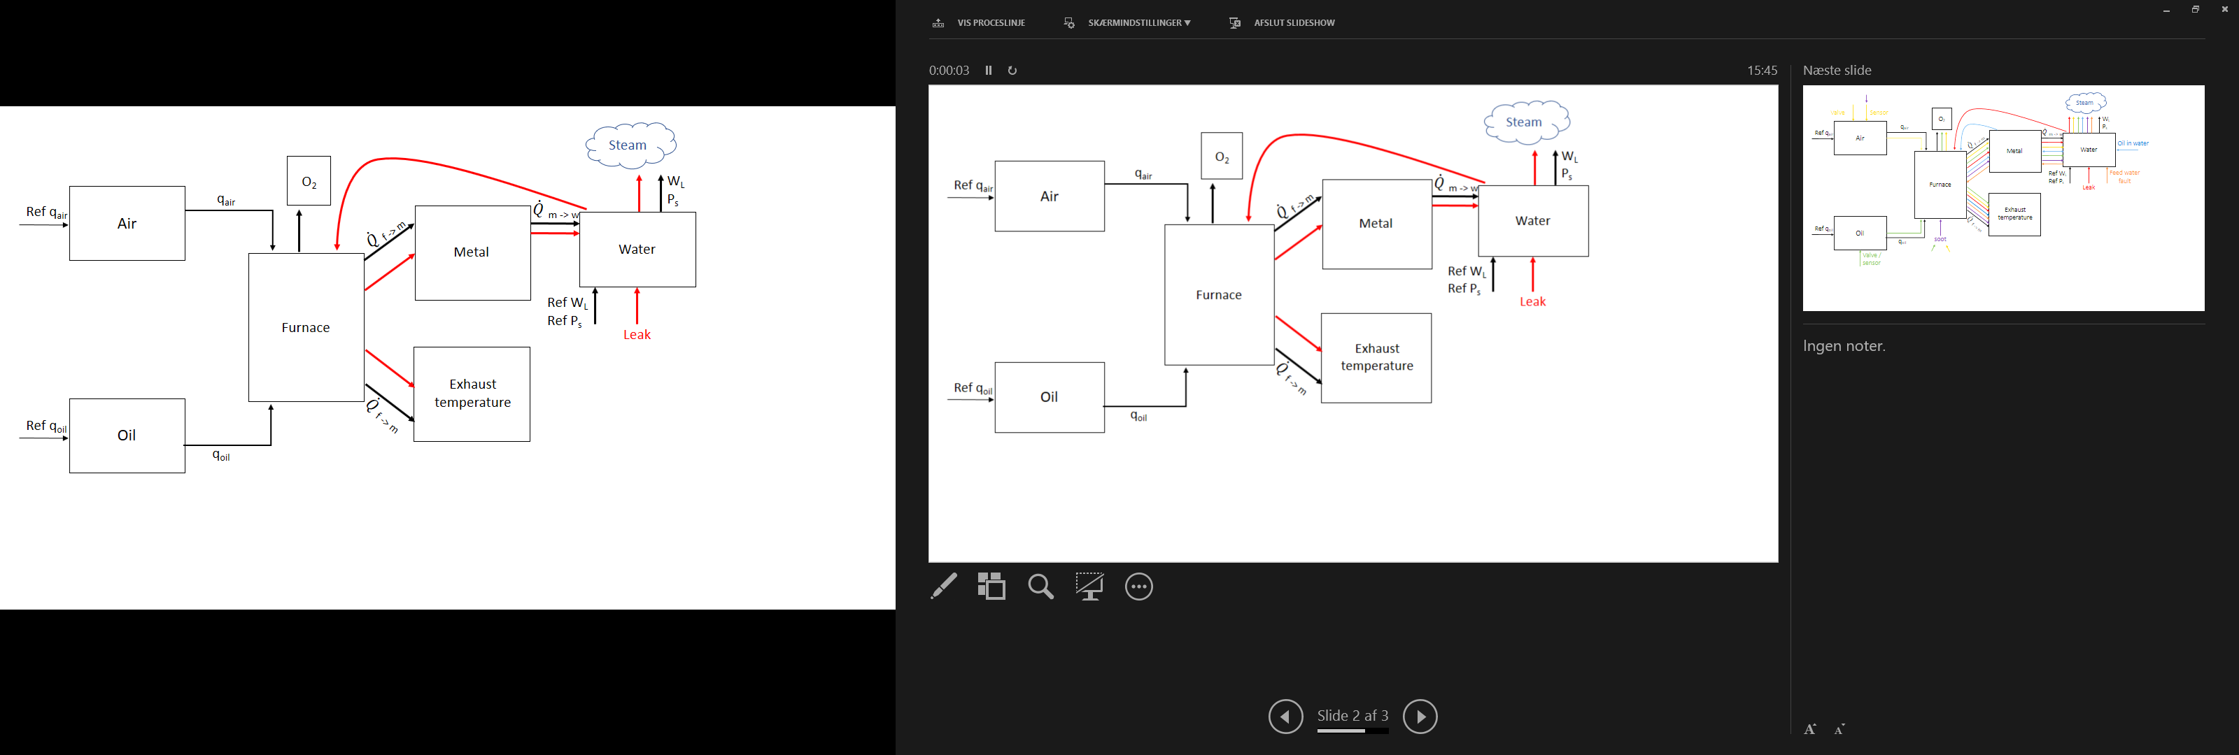
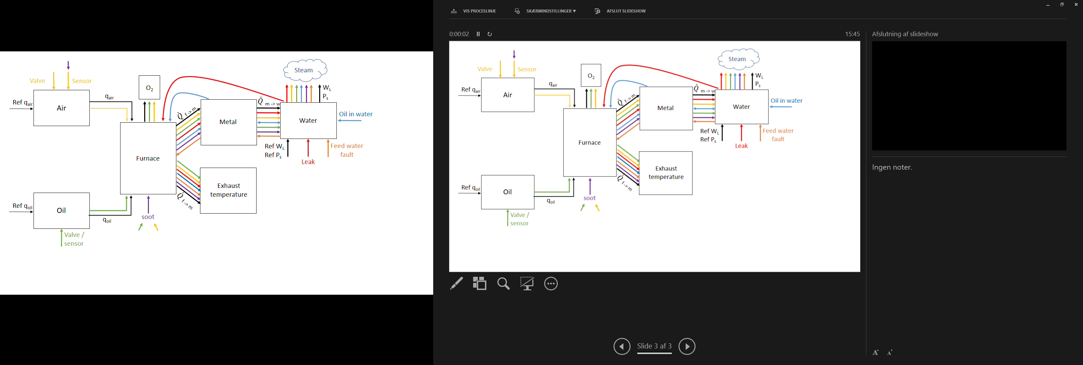
Fault detection analysis
The faults are incipient and convoluted
Missing sensors to isolate faults from each other and disturbances

Slide 9
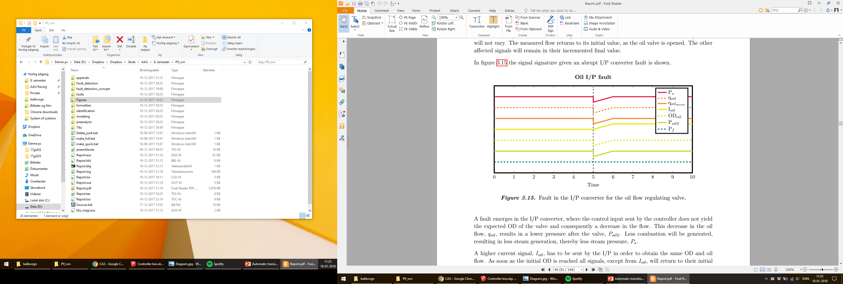
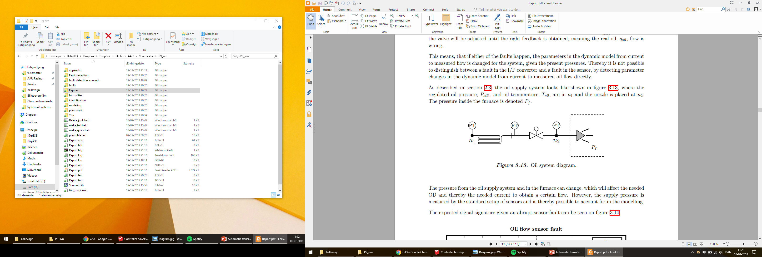
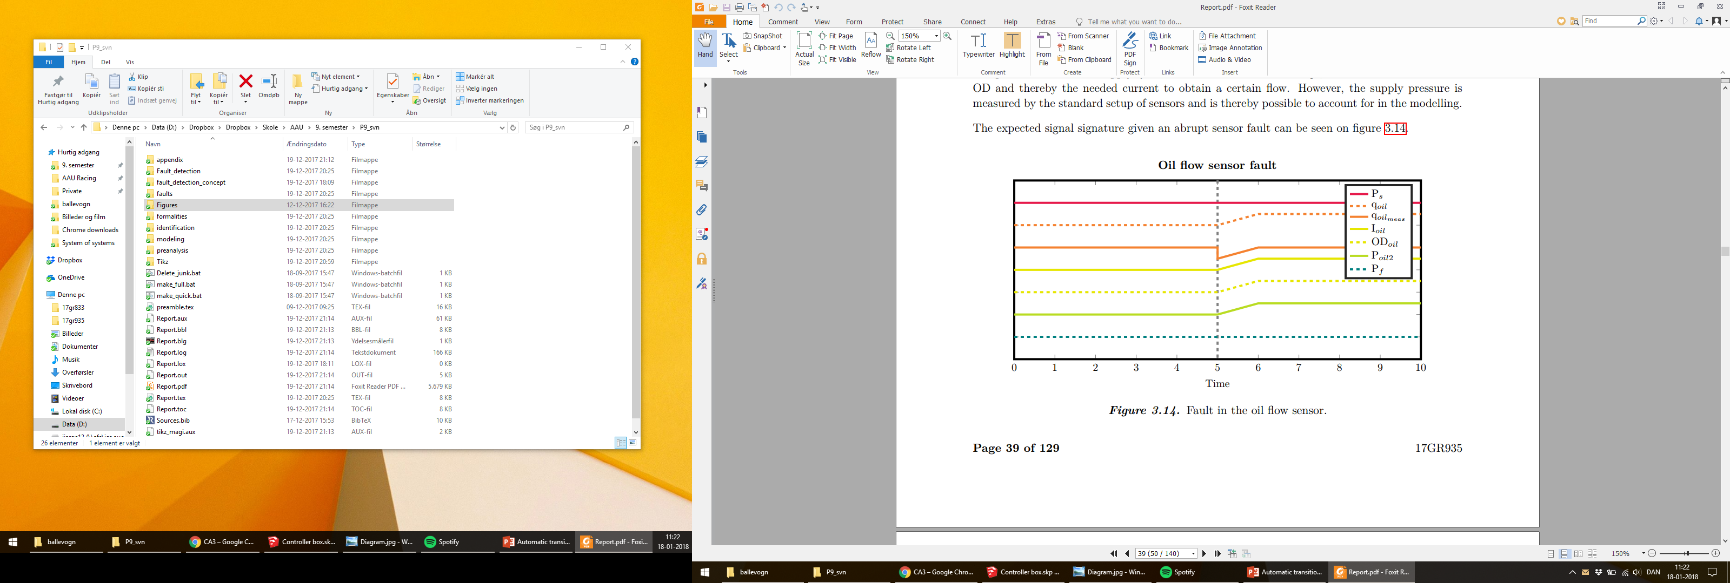
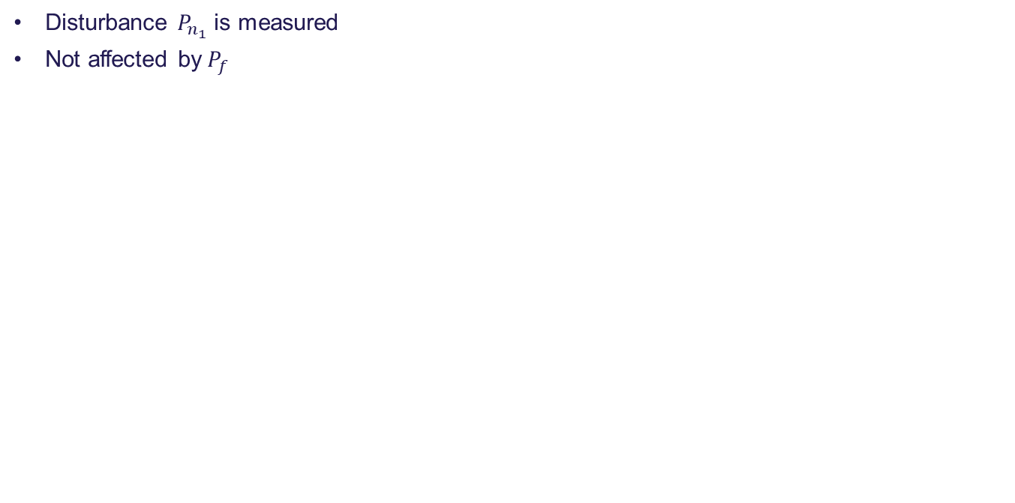
Detection and isolation are possible in the oil supply system
Disturbance $P_{n_{1}}$ is measured
Not affected by$P_{f}$

Slide 10
Agenda
Jesper:
Introduction
Project and system description
Typical faults
Fault analysis example
Jonas:
Fault detection concept
Modelling
Closed loop identification with Hansen Scheme
Ignacio:
Closed loop identification with grey box estimation
Fault detection design
Conclusion and future work

Slide 11
Fault detection concept
What do we want?
Should work for any vessel with OL boiler
Should not make commissioning and use more complicated
Automatic identification of the system
Avoid disturbance of steam output
Passive fault detection
Fault detection method choice
Process model based method robust to disturbances
Unknown input observer

Slide 12
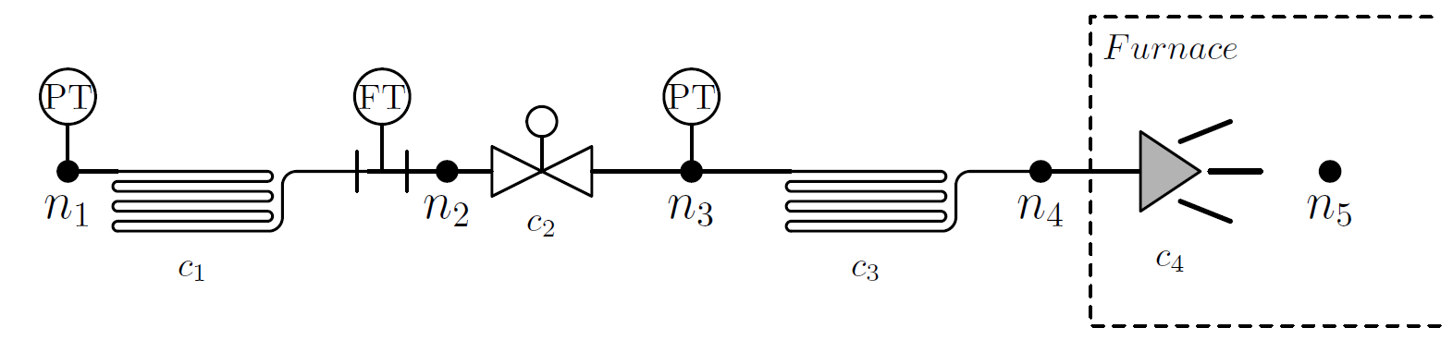
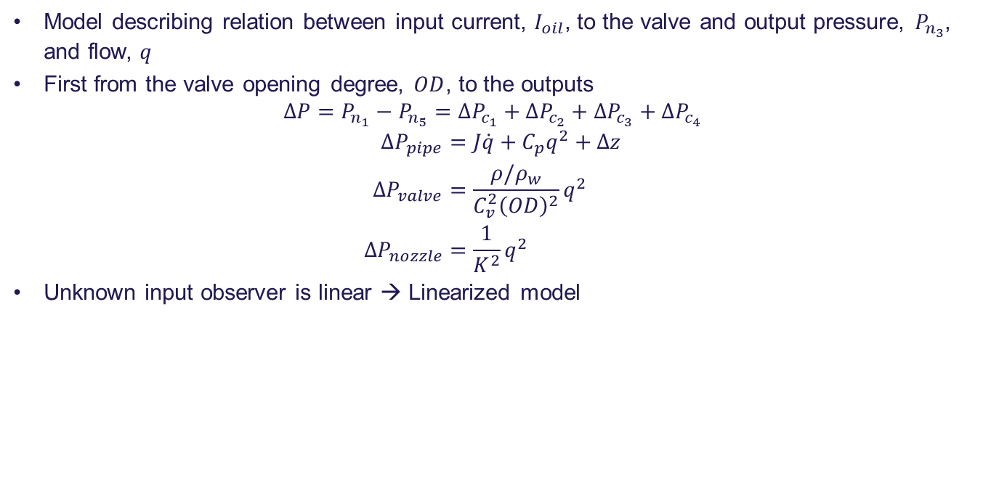
Modelling of oil feed system
Model describing relation between input current, $I_{oil}$, to the valve and output pressure, $P_{n_{3}}$, and flow, $q$
First from the valve opening degree, $OD$, to the outputs
$$ΔP=P_{n_{1}}−P_{n_{5}}=ΔP_{c_{1}}+ΔP_{c_{2}}+ΔP_{c_{3}}+ΔP_{c_{4}}$$
$$\begin{aligned}ΔP_{pipe}&=J\dot{q}+C_{p}q^{2}+Δz \\ ΔP_{valve}&=\frac{ρ/ρ_{w}}{C_{v}^{2}{\left(OD\right)}^{2}}q^{2} \\ ΔP_{nozzle}&=\frac{1}{K^{2}}q^{2}\end{aligned}$$
Unknown input observer is linear → Linearized model

Slide 13
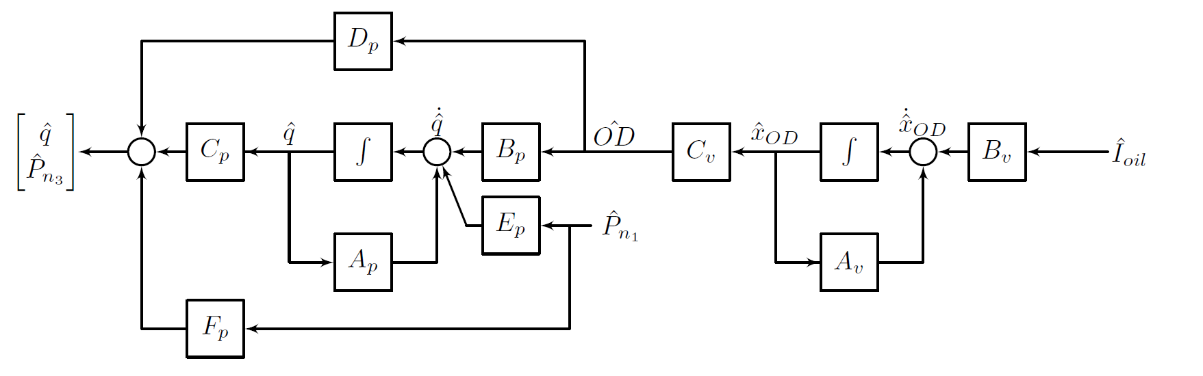
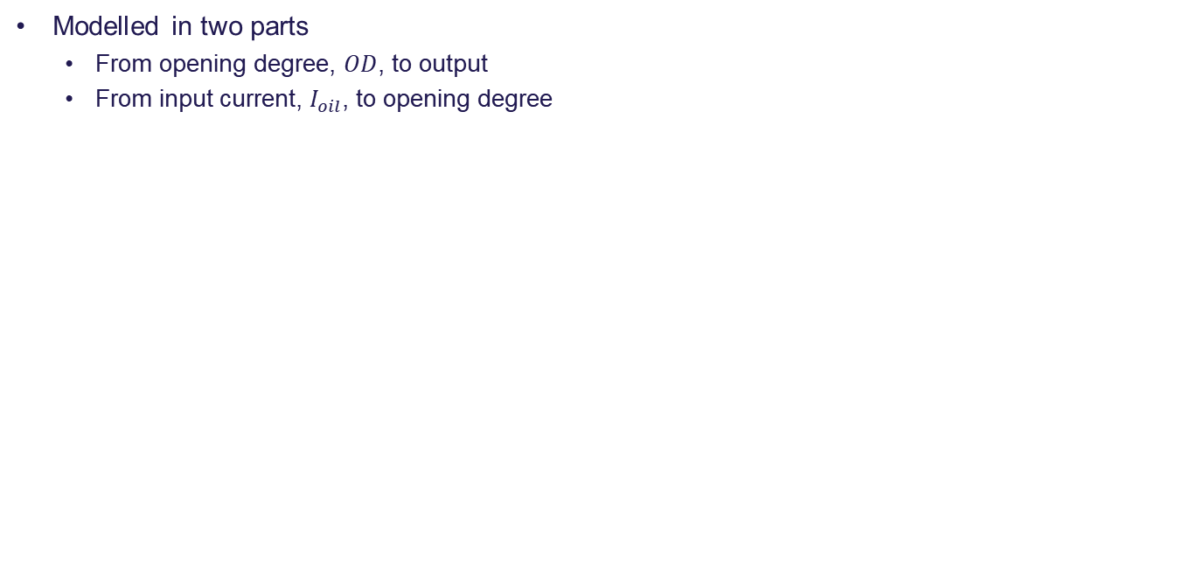
Modelling of oil feed system
Modelled in two parts
From opening degree, $OD$, to output
From input current, $I_{oil}$, to opening degree

Slide 14
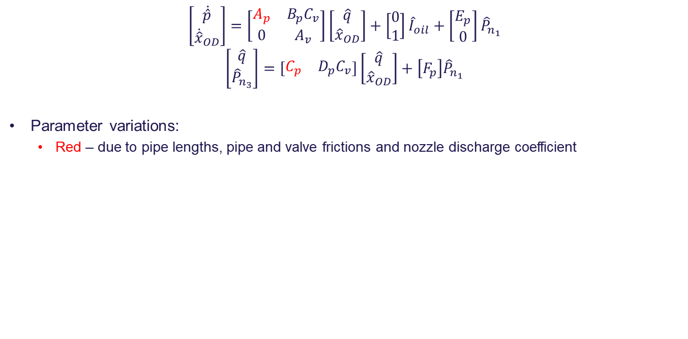
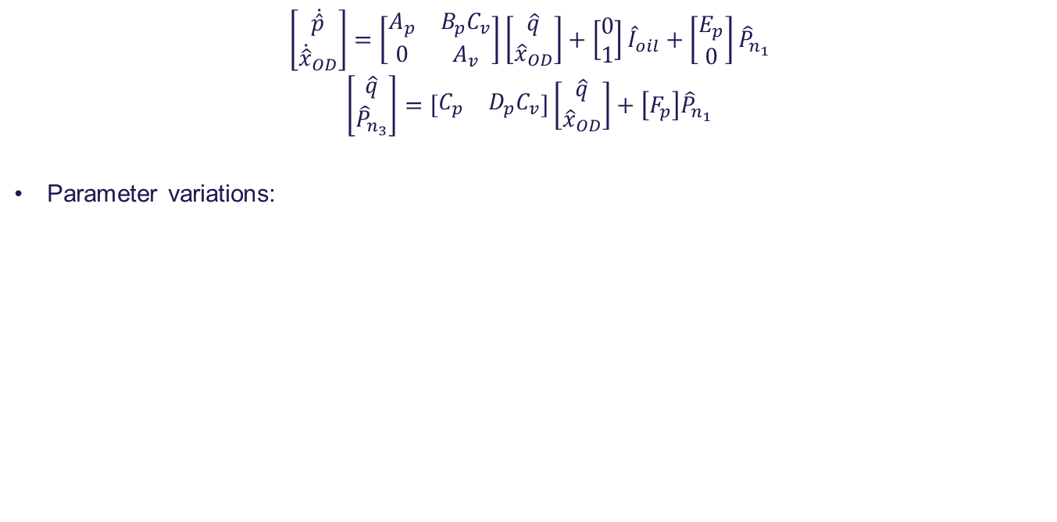
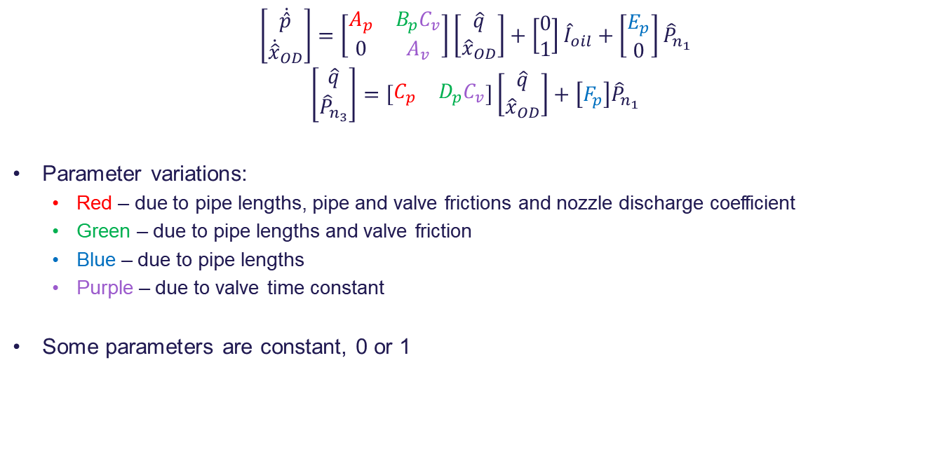
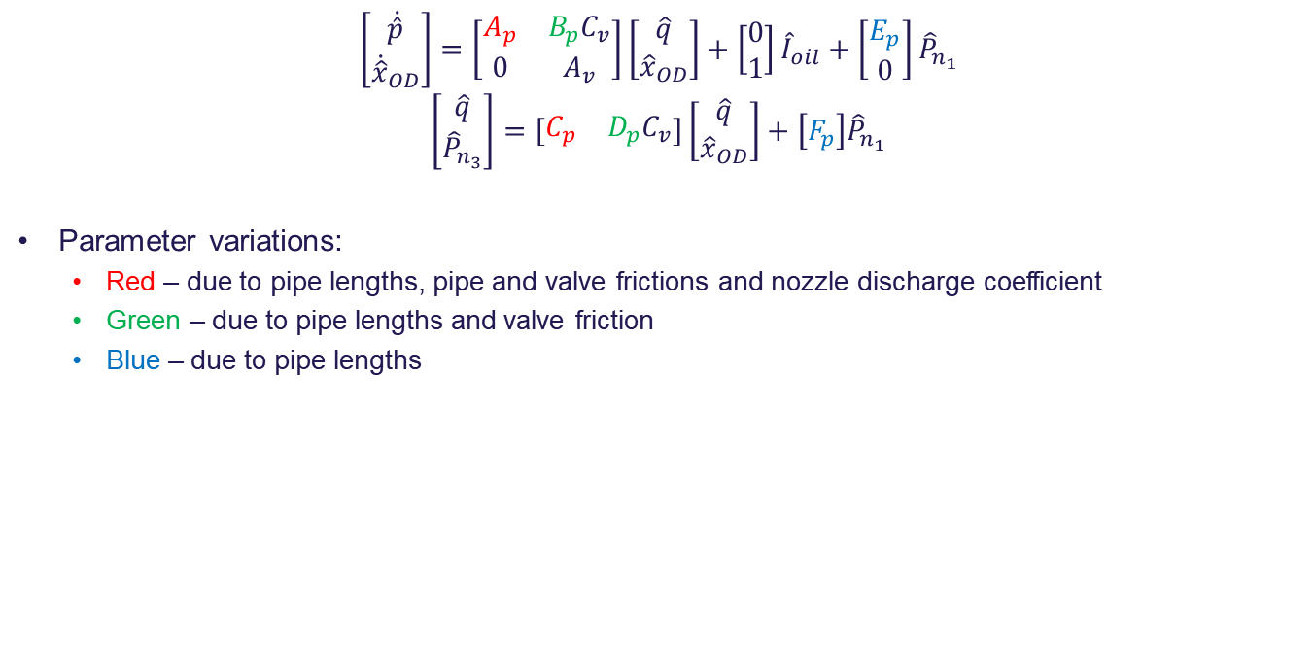
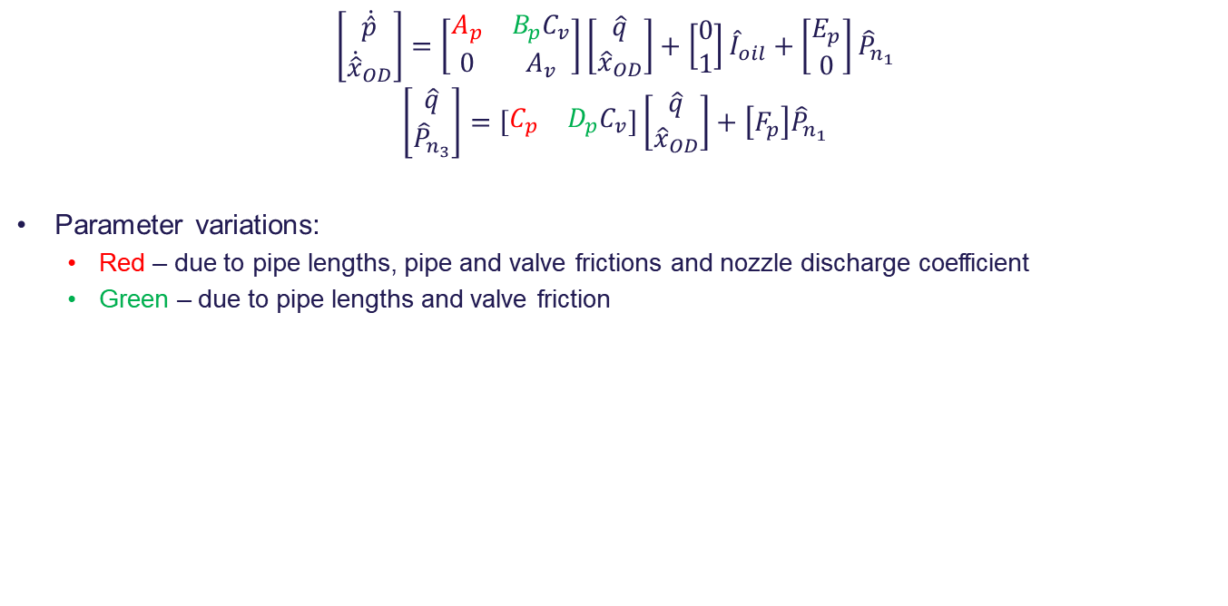
State space model
$$\left[\begin{aligned}\dot{\hat{p}} \\ {\dot{\hat{x}}}_{OD}\end{aligned}\right]=\left[\begin{matrix}A_{p} & B_{p}C_{v} \\ 0 & A_{v}\end{matrix}\right]\left[\begin{aligned}\hat{q} \\ {\hat{x}}_{OD}\end{aligned}\right]+\left[\begin{aligned}0 \\ 1\end{aligned}\right]{\hat{I}}_{oil}+\left[\begin{aligned}E_{p} \\ 0\end{aligned}\right]{\hat{P}}_{n_{1}}$$
$$\left[\begin{aligned}\hat{q} \\ {\hat{P}}_{n_{3}}\end{aligned}\right]=\left[\begin{matrix}C_{p} & D_{p}C_{v}\end{matrix}\right]\left[\begin{aligned}\hat{q} \\ {\hat{x}}_{OD}\end{aligned}\right]+\left[F_{p}\right]{\hat{P}}_{n_{1}}$$
Parameter variations:
$$\left[\begin{aligned}\dot{\hat{p}} \\ {\dot{\hat{x}}}_{OD}\end{aligned}\right]=\left[\begin{matrix}A_{p} & B_{p}C_{v} \\ 0 & A_{v}\end{matrix}\right]\left[\begin{aligned}\hat{q} \\ {\hat{x}}_{OD}\end{aligned}\right]+\left[\begin{aligned}0 \\ 1\end{aligned}\right]{\hat{I}}_{oil}+\left[\begin{aligned}E_{p} \\ 0\end{aligned}\right]{\hat{P}}_{n_{1}}$$
$$\left[\begin{aligned}\hat{q} \\ {\hat{P}}_{n_{3}}\end{aligned}\right]=\left[\begin{matrix}C_{p} & D_{p}C_{v}\end{matrix}\right]\left[\begin{aligned}\hat{q} \\ {\hat{x}}_{OD}\end{aligned}\right]+\left[F_{p}\right]{\hat{P}}_{n_{1}}$$
Parameter variations:
Red – due to pipe lengths, pipe and valve frictions and nozzle discharge coefficient
$$\left[\begin{aligned}\dot{\hat{p}} \\ {\dot{\hat{x}}}_{OD}\end{aligned}\right]=\left[\begin{matrix}A_{p} & B_{p}C_{v} \\ 0 & A_{v}\end{matrix}\right]\left[\begin{aligned}\hat{q} \\ {\hat{x}}_{OD}\end{aligned}\right]+\left[\begin{aligned}0 \\ 1\end{aligned}\right]{\hat{I}}_{oil}+\left[\begin{aligned}E_{p} \\ 0\end{aligned}\right]{\hat{P}}_{n_{1}}$$
$$\left[\begin{aligned}\hat{q} \\ {\hat{P}}_{n_{3}}\end{aligned}\right]=\left[\begin{matrix}C_{p} & D_{p}C_{v}\end{matrix}\right]\left[\begin{aligned}\hat{q} \\ {\hat{x}}_{OD}\end{aligned}\right]+\left[F_{p}\right]{\hat{P}}_{n_{1}}$$
Parameter variations:
Red – due to pipe lengths, pipe and valve frictions and nozzle discharge coefficient
Green – due to pipe lengths and valve friction
$$\left[\begin{aligned}\dot{\hat{p}} \\ {\dot{\hat{x}}}_{OD}\end{aligned}\right]=\left[\begin{matrix}A_{p} & B_{p}C_{v} \\ 0 & A_{v}\end{matrix}\right]\left[\begin{aligned}\hat{q} \\ {\hat{x}}_{OD}\end{aligned}\right]+\left[\begin{aligned}0 \\ 1\end{aligned}\right]{\hat{I}}_{oil}+\left[\begin{aligned}E_{p} \\ 0\end{aligned}\right]{\hat{P}}_{n_{1}}$$
$$\left[\begin{aligned}\hat{q} \\ {\hat{P}}_{n_{3}}\end{aligned}\right]=\left[\begin{matrix}C_{p} & D_{p}C_{v}\end{matrix}\right]\left[\begin{aligned}\hat{q} \\ {\hat{x}}_{OD}\end{aligned}\right]+\left[F_{p}\right]{\hat{P}}_{n_{1}}$$
Parameter variations:
Red – due to pipe lengths, pipe and valve frictions and nozzle discharge coefficient
Green – due to pipe lengths and valve friction
Blue – due to pipe lengths
$$\left[\begin{aligned}\dot{\hat{p}} \\ {\dot{\hat{x}}}_{OD}\end{aligned}\right]=\left[\begin{matrix}A_{p} & B_{p}C_{v} \\ 0 & A_{v}\end{matrix}\right]\left[\begin{aligned}\hat{q} \\ {\hat{x}}_{OD}\end{aligned}\right]+\left[\begin{aligned}0 \\ 1\end{aligned}\right]{\hat{I}}_{oil}+\left[\begin{aligned}E_{p} \\ 0\end{aligned}\right]{\hat{P}}_{n_{1}}$$
$$\left[\begin{aligned}\hat{q} \\ {\hat{P}}_{n_{3}}\end{aligned}\right]=\left[\begin{matrix}C_{p} & D_{p}C_{v}\end{matrix}\right]\left[\begin{aligned}\hat{q} \\ {\hat{x}}_{OD}\end{aligned}\right]+\left[F_{p}\right]{\hat{P}}_{n_{1}}$$
Parameter variations:
Red – due to pipe lengths, pipe and valve frictions and nozzle discharge coefficient
Green – due to pipe lengths and valve friction
Blue – due to pipe lengths
Purple – due to valve time constant
Some parameters are constant, 0 or 1

Slide 15
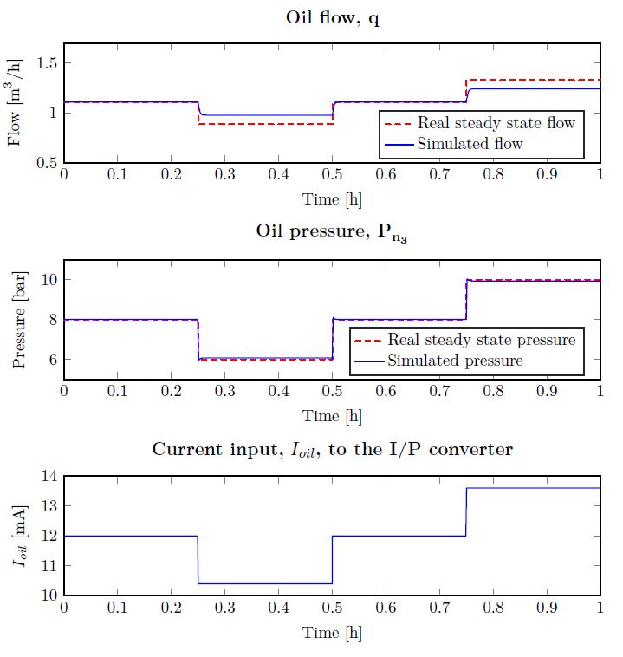
Model estimation
Estimation based on single steady state values
Model made for 50 % OD
Handtuned PID controllers for making closed loop system as on the vessel

Slide 16
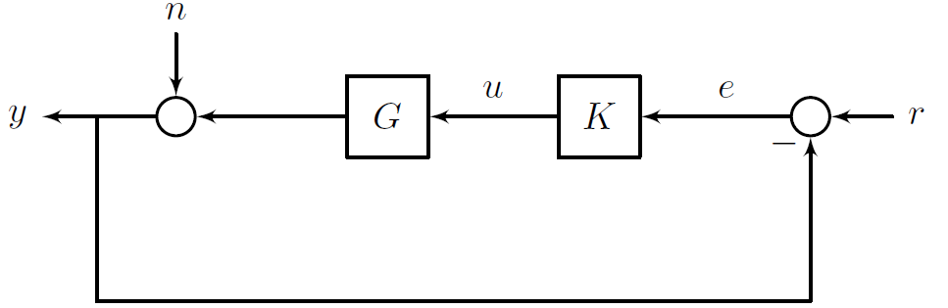
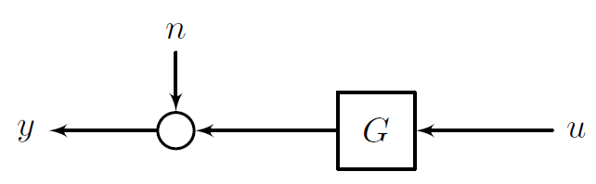
Closed-loop identification
Closed loop vs open loop identification
Closed loop
Input correlated with noise
Is done while system is operating
Open loop
No correlation with noise
Needs to take system out of operation
Initial guess is 25 % larger in all varying parameters

Slide 17
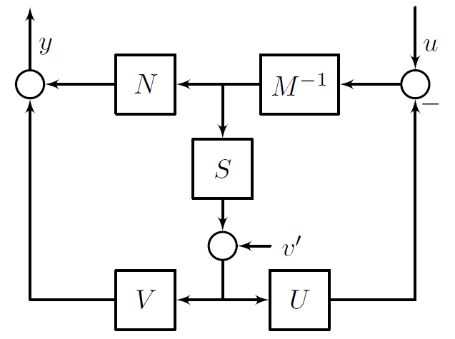
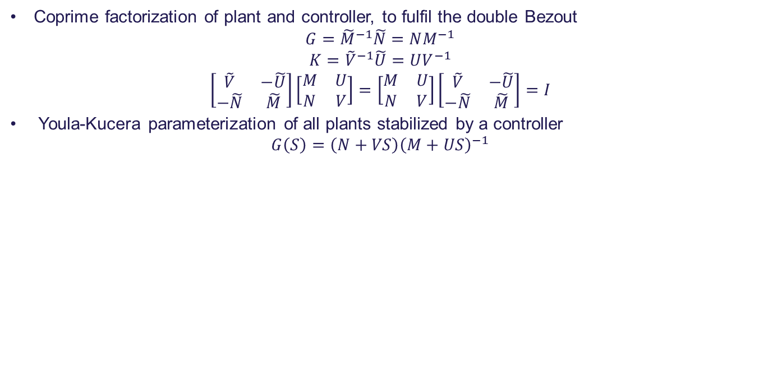
Hansen Scheme – Prerequisites
Coprime factorization of plant and controller, to fulfil the double Bezout
$$G={\tilde{M}}^{−1}\tilde{N}=NM^{−1}$$
$$K={\tilde{V}}^{−1}\tilde{U}=UV^{−1}$$
$$\left[\begin{matrix}\tilde{V} & −\tilde{U} \\ −\tilde{N} & \tilde{M}\end{matrix}\right]\left[\begin{matrix}M & U \\ N & V\end{matrix}\right]=\left[\begin{matrix}M & U \\ N & V\end{matrix}\right]\left[\begin{matrix}\tilde{V} & −\tilde{U} \\ −\tilde{N} & \tilde{M}\end{matrix}\right]=I$$
Youla-Kucera parameterization of all plants stabilized by a controller
$$G\left(S\right)=\left(N+VS\right){\left(M+US\right)}^{−1}$$

Slide 18
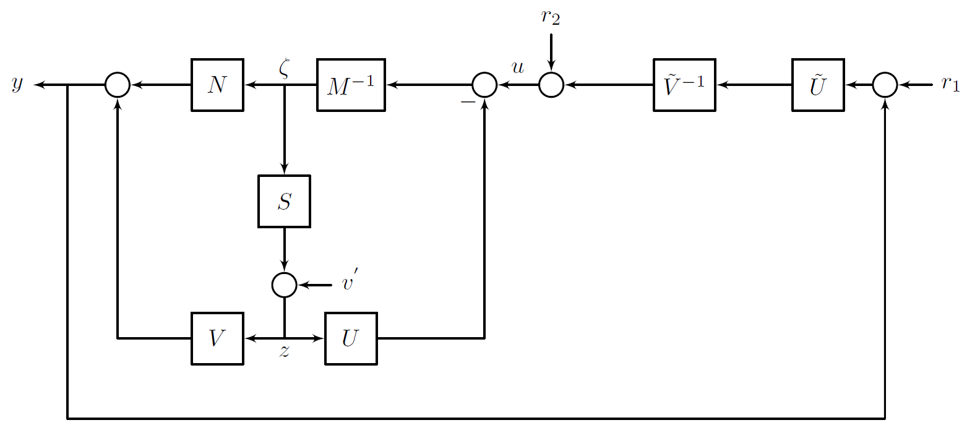
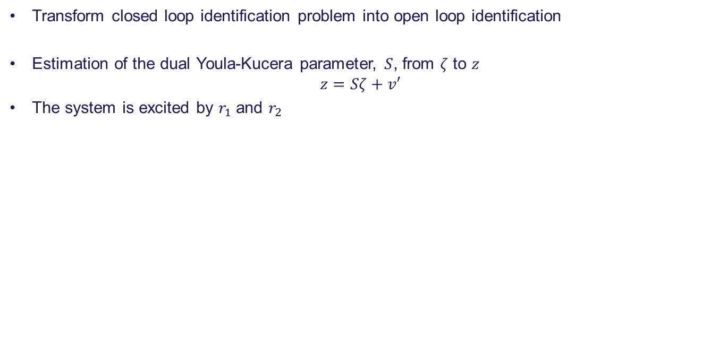
Hansen Scheme
Transform closed loop identification problem into open loop identification
Estimation of the dual Youla-Kucera parameter, $S$, from $ζ$ to $z$
$$z=Sζ+v′$$
The system is excited by $r_{1}$ and $r_{2}$

Slide 19
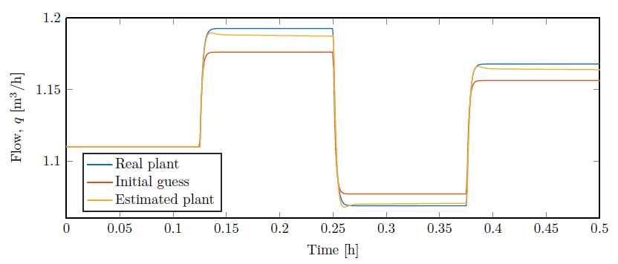
Hansen Scheme simulation
Good input-output fit
High order system → Model reduction is needed
Garbled states → No physical interpretation

Slide 20
Agenda
Jesper:
Introduction
Project and system description
Typical faults
Fault analysis example
Jonas:
Fault detection concept
Modelling
Closed loop identification with Hansen Scheme
Ignacio:
Closed loop identification with grey box estimation
Fault detection design
Conclusion and future work

Slide 21
Direct Identification
Hansen Scheme resulted not suitable for this project
Due to time constraints a direct identification method is used
MATLAB linear grey box is used instead
Open loop identification method
Possibility to fix parameters in the estimation
Estimation carried out Steepest descent method
The simplest method to available
Easiest to implement on a real system

Slide 22
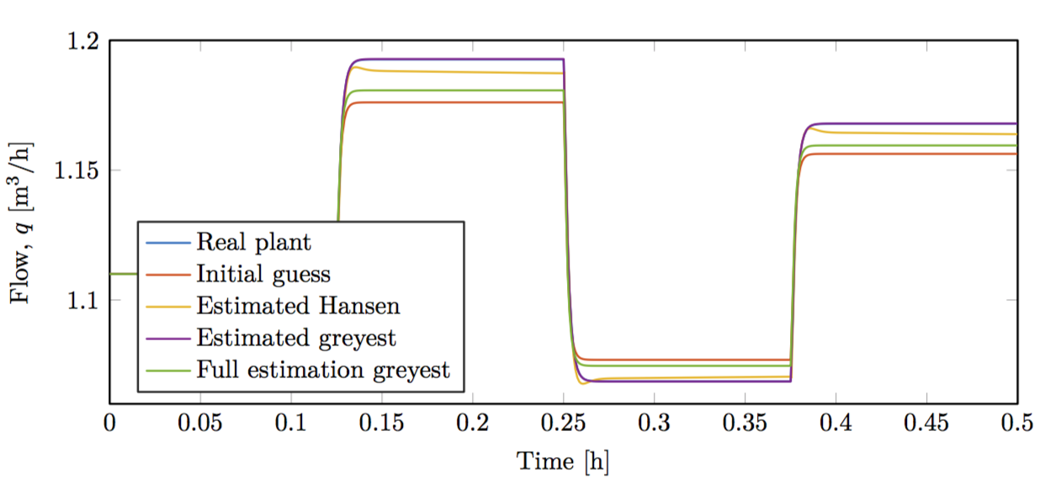
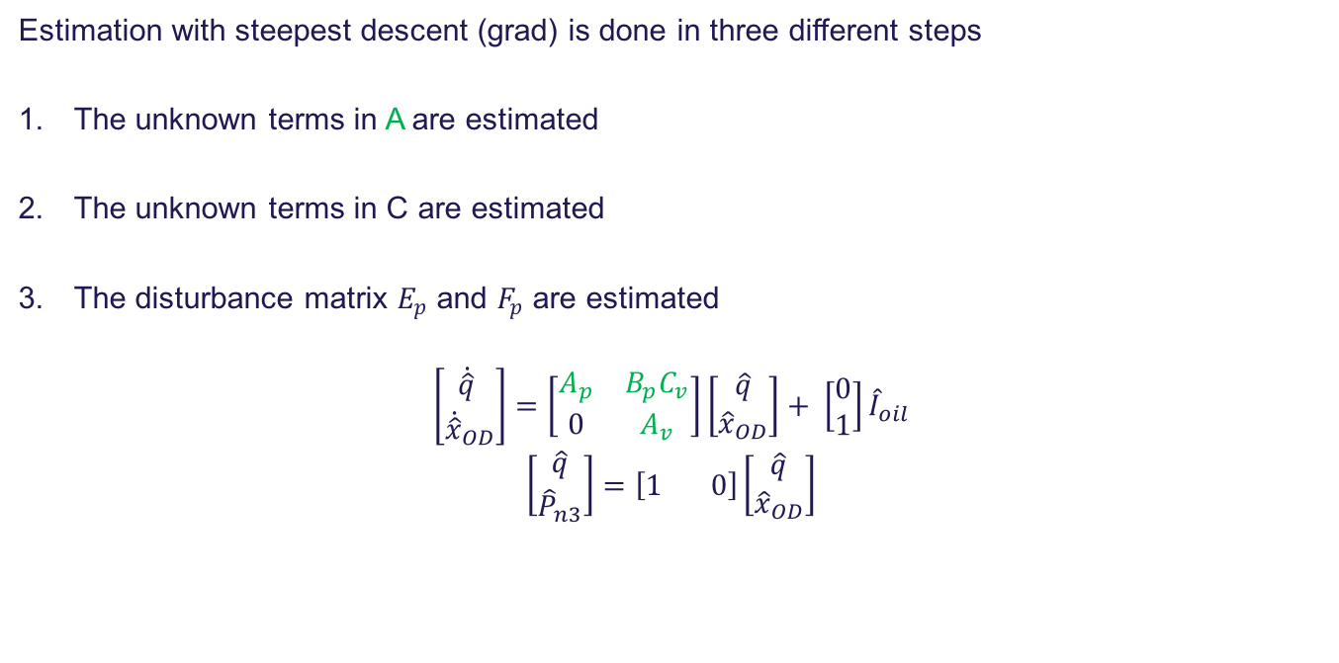
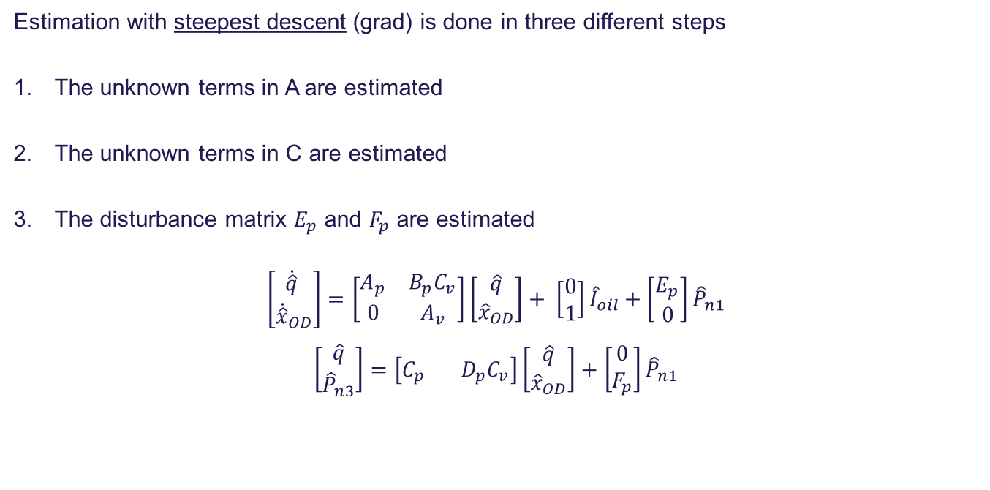
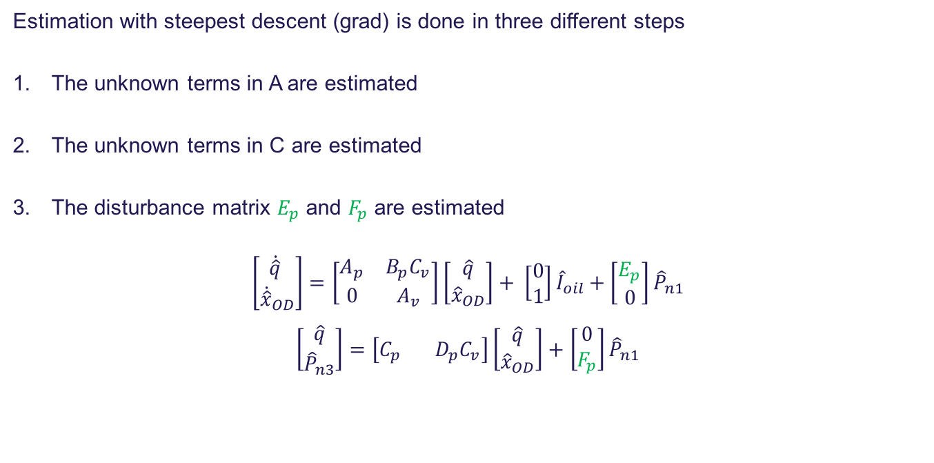
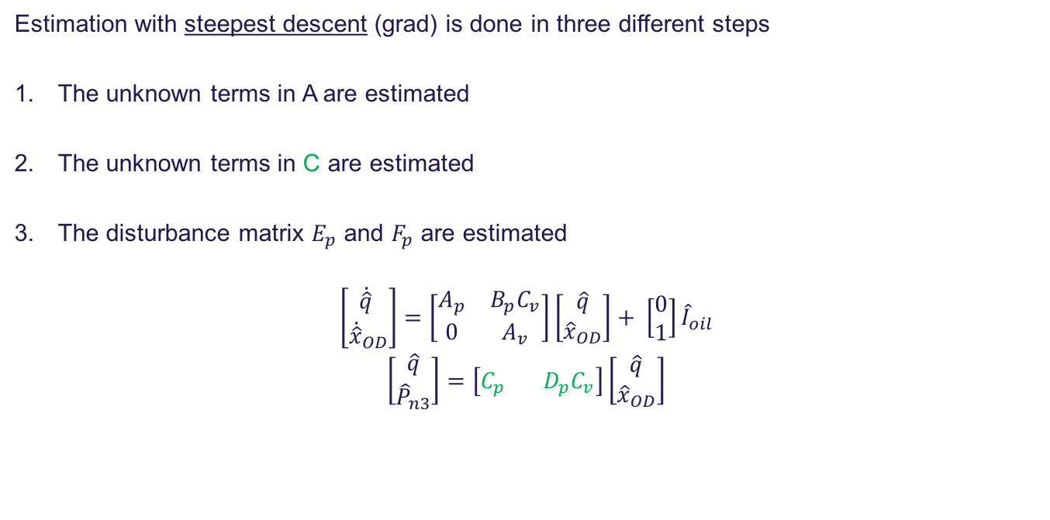
Direct Identification
Estimation with steepest descent (grad) is done in three different steps
The unknown terms in A are estimated
The unknown terms in C are estimated
The disturbance matrix $E_{p}$ and $F_{p}$ are estimated
$$\left[\begin{aligned}\dot{\hat{q}} \\ {\dot{\hat{x}}}_{OD}\end{aligned}\right]=\left[\begin{matrix}A_{p} & B_{p}C_{v} \\ 0 & A_{v}\end{matrix}\right]\left[\begin{aligned}\hat{q} \\ {\hat{x}}_{OD}\end{aligned}\right]+ \left[\begin{aligned}0 \\ 1\end{aligned}\right]{\hat{I}}_{oil}$$
$$\left[\begin{aligned}\hat{q} \\ {\hat{P}}_{n3}\end{aligned}\right]=\left[1 0\right]\left[\begin{aligned}\hat{q} \\ {\hat{x}}_{OD}\end{aligned}\right]$$
Estimation with steepest descent (grad) is done in three different steps
The unknown terms in A are estimated
The unknown terms in C are estimated
The disturbance matrix $E_{p}$ and $F_{p}$ are estimated
$$\left[\begin{aligned}\dot{\hat{q}} \\ {\dot{\hat{x}}}_{OD}\end{aligned}\right]=\left[\begin{matrix}A_{p} & B_{p}C_{v} \\ 0 & A_{v}\end{matrix}\right]\left[\begin{aligned}\hat{q} \\ {\hat{x}}_{OD}\end{aligned}\right]+ \left[\begin{aligned}0 \\ 1\end{aligned}\right]{\hat{I}}_{oil}$$
$$\left[\begin{aligned}\hat{q} \\ {\hat{P}}_{n3}\end{aligned}\right]=\left[C_{p} D_{p}C_{v}\right]\left[\begin{aligned}\hat{q} \\ {\hat{x}}_{OD}\end{aligned}\right]$$
Estimation with steepest descent (grad) is done in three different steps
The unknown terms in A are estimated
The unknown terms in C are estimated
The disturbance matrix $E_{p}$ and $F_{p}$ are estimated
$$\left[\begin{aligned}\dot{\hat{q}} \\ {\dot{\hat{x}}}_{OD}\end{aligned}\right]=\left[\begin{matrix}A_{p} & B_{p}C_{v} \\ 0 & A_{v}\end{matrix}\right]\left[\begin{aligned}\hat{q} \\ {\hat{x}}_{OD}\end{aligned}\right]+ \left[\begin{aligned}0 \\ 1\end{aligned}\right]{\hat{I}}_{oil}+\left[\begin{aligned}E_{p} \\ 0\end{aligned}\right]{\hat{P}}_{n1}$$
$\left[\begin{aligned}\hat{q} \\ {\hat{P}}_{n3}\end{aligned}\right]=\left[C_{p} D_{p}C_{v}\right]\left[\begin{aligned}\hat{q} \\ {\hat{x}}_{OD}\end{aligned}\right]+\left[\begin{aligned}0 \\ F_{p}\end{aligned}\right]{\hat{P}}_{n1}$
Estimation with steepest descent (grad) is done in three different steps
The unknown terms in A are estimated
The unknown terms in C are estimated
The disturbance matrix $E_{p}$ and $F_{p}$ are estimated
$$\left[\begin{aligned}\dot{\hat{q}} \\ {\dot{\hat{x}}}_{OD}\end{aligned}\right]=\left[\begin{matrix}A_{p} & B_{p}C_{v} \\ 0 & A_{v}\end{matrix}\right]\left[\begin{aligned}\hat{q} \\ {\hat{x}}_{OD}\end{aligned}\right]+ \left[\begin{aligned}0 \\ 1\end{aligned}\right]{\hat{I}}_{oil}+\left[\begin{aligned}E_{p} \\ 0\end{aligned}\right]{\hat{P}}_{n1}$$
$\left[\begin{aligned}\hat{q} \\ {\hat{P}}_{n3}\end{aligned}\right]=\left[C_{p} D_{p}C_{v}\right]\left[\begin{aligned}\hat{q} \\ {\hat{x}}_{OD}\end{aligned}\right]+\left[\begin{aligned}0 \\ F_{p}\end{aligned}\right]{\hat{P}}_{n1}$
By estimating the matrices with different methods the following input output relation is obtained.

Slide 23
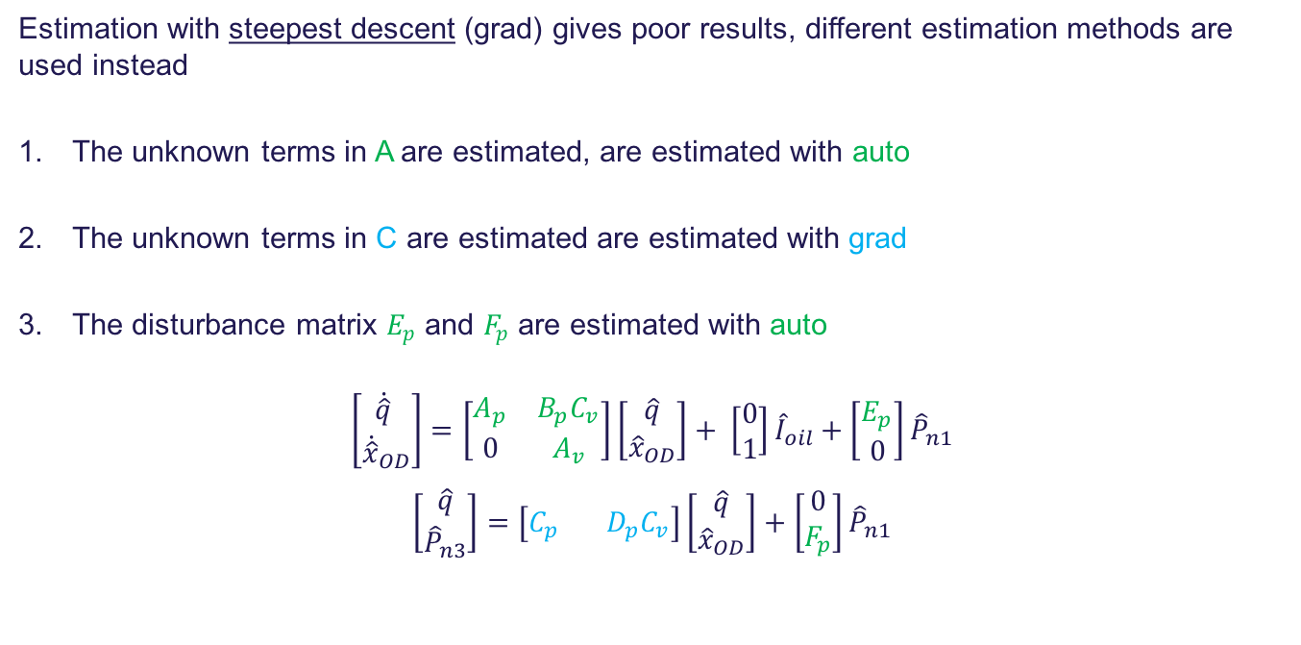
Direct Identification
Estimation with steepest descent (grad) gives poor results, different estimation methods are used instead
The unknown terms in A are estimated, are estimated with auto
The unknown terms in C are estimated are estimated with grad
The disturbance matrix $E_{p}$ and $F_{p}$ are estimated with auto
$$\left[\begin{aligned}\dot{\hat{q}} \\ {\dot{\hat{x}}}_{OD}\end{aligned}\right]=\left[\begin{matrix}A_{p} & B_{p}C_{v} \\ 0 & A_{v}\end{matrix}\right]\left[\begin{aligned}\hat{q} \\ {\hat{x}}_{OD}\end{aligned}\right]+ \left[\begin{aligned}0 \\ 1\end{aligned}\right]{\hat{I}}_{oil}+\left[\begin{aligned}E_{p} \\ 0\end{aligned}\right]{\hat{P}}_{n1}$$
$\left[\begin{aligned}\hat{q} \\ {\hat{P}}_{n3}\end{aligned}\right]=\left[C_{p} D_{p}C_{v}\right]\left[\begin{aligned}\hat{q} \\ {\hat{x}}_{OD}\end{aligned}\right]+\left[\begin{aligned}0 \\ F_{p}\end{aligned}\right]{\hat{P}}_{n1}$

Slide 24
Fault detection and isolation
A model fitting the real system has been obtained
Two faults are desired to detect and isolate
I/P converter on oil flow valves
Oil flow sensor
In order to detect the faults, a model based Unknown Input Observer (UIO) is designed
The isolation of the faults is carried out afterwards by filtering with Moving Average

Slide 25
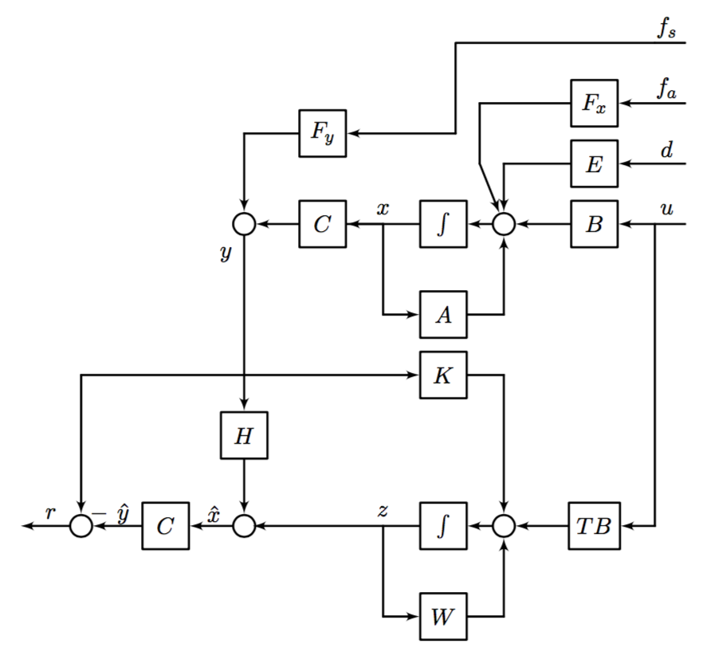
Fault detection
Unknown Input Observer
Decouples the disturbances entering the
system
Delivers a correct and robust state estimation
robust towards noise and disturbance
Two observers are needed, one for each of
the faults

Slide 26
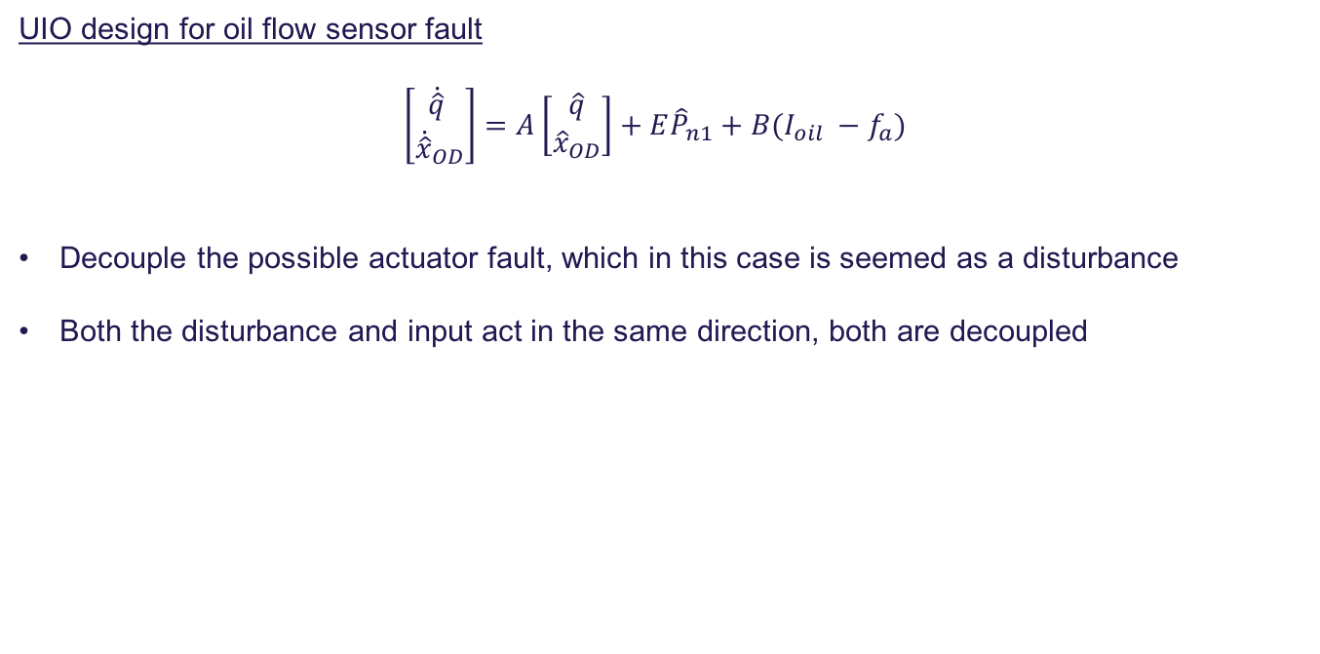
Fault detection
UIO design for oil flow sensor fault
$$\left[\begin{aligned}\dot{\hat{q}} \\ {\dot{\hat{x}}}_{OD}\end{aligned}\right]=A\left[\begin{aligned}\hat{q} \\ {\hat{x}}_{OD}\end{aligned}\right]+E{\hat{P}}_{n1}+B(I_{oil} −f_{a})$$
Decouple the possible actuator fault, which in this case is seemed as a disturbance
Both the disturbance and input act in the same direction, both are decoupled

Slide 27
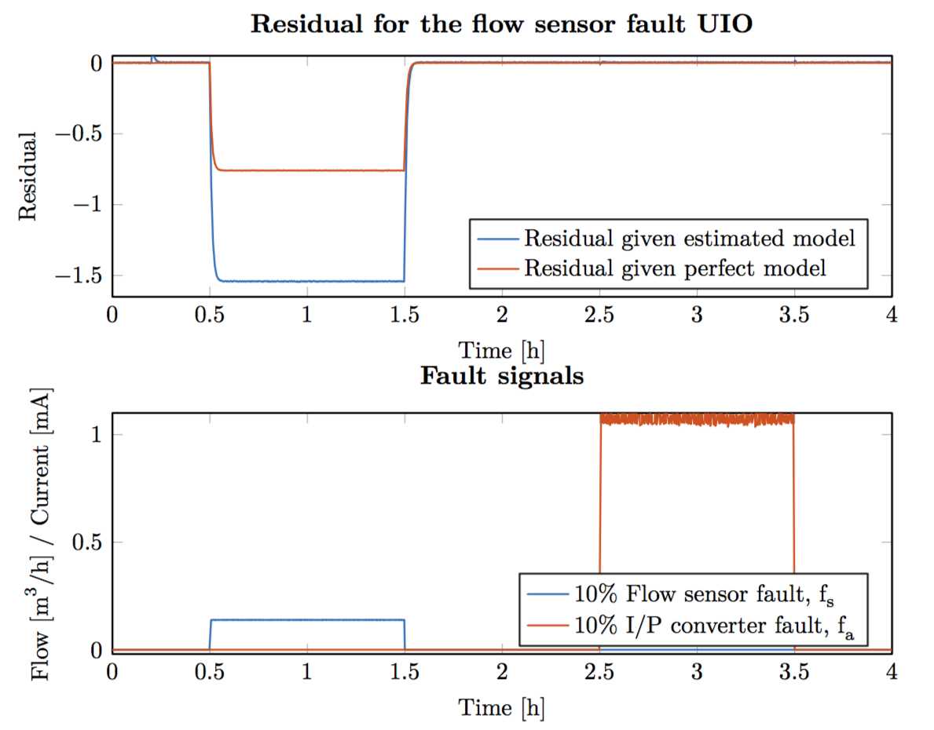
Fault detection
UIO design for oil flow sensor fault
Two faults are introduced
Chosen to be 10 % of a fully
dead sensor or actuator
The sensor UIO reacts only
for the sensor fault

Slide 28
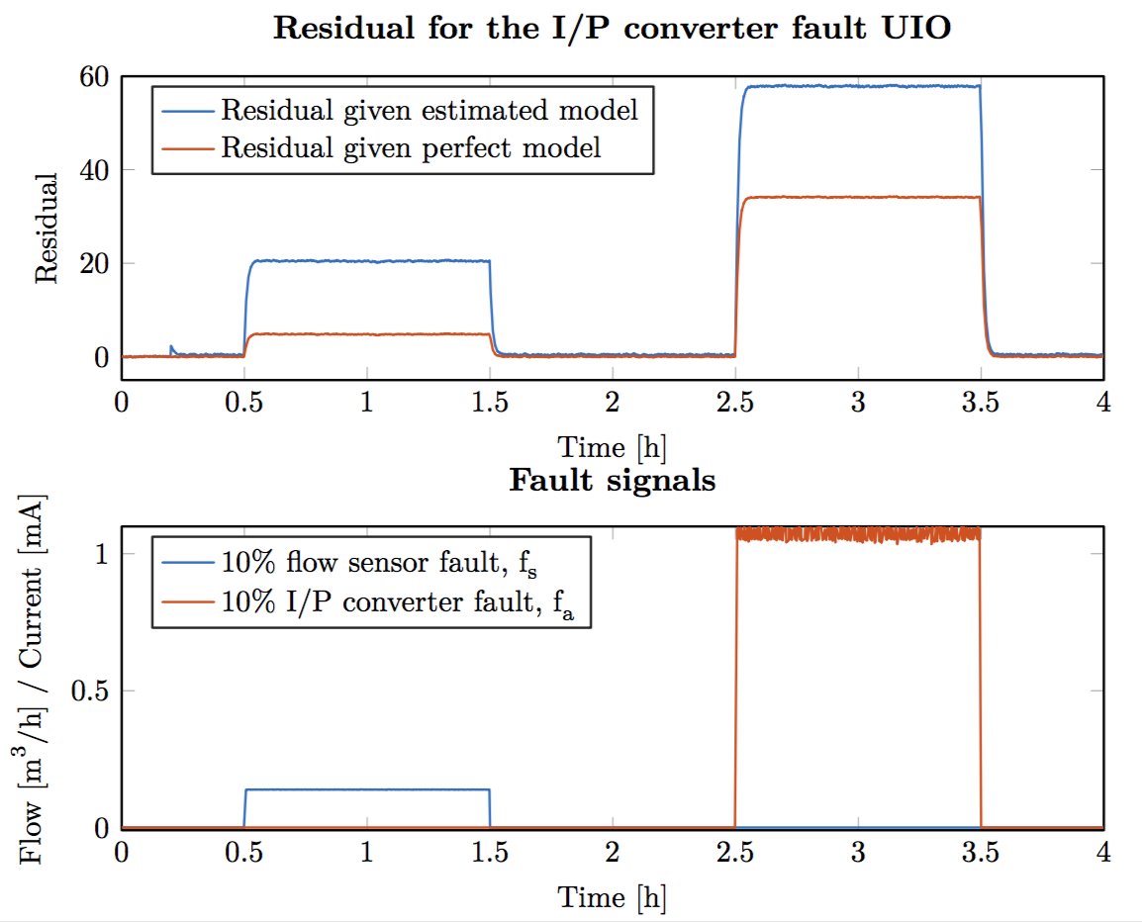
Fault detection
UIO design for I/P converter fault
It has not been possible to
decouple the sensor fault
UIO sensible to both faults is
designed
The estimated model deviates
slightly from zero

Slide 29
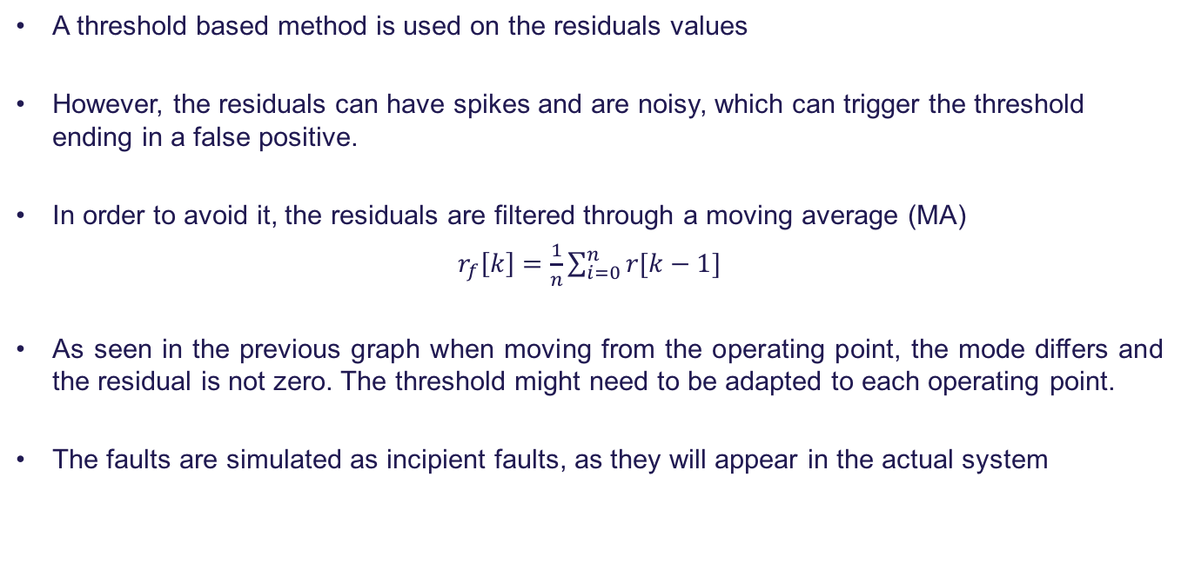
Fault Detection and Isolation
A threshold based method is used on the residuals values
However, the residuals can have spikes and are noisy, which can trigger the threshold ending in a false positive.
In order to avoid it, the residuals are filtered through a moving average (MA)
$r_{f}\left[k\right]=\frac{1}{n}\sum_{i=0}^{n}{r[k−1]}$
As seen in the previous graph when moving from the operating point, the mode differs and the residual is not zero. The threshold might need to be adapted to each operating point.
The faults are simulated as incipient faults, as they will appear in the actual system

Slide 30
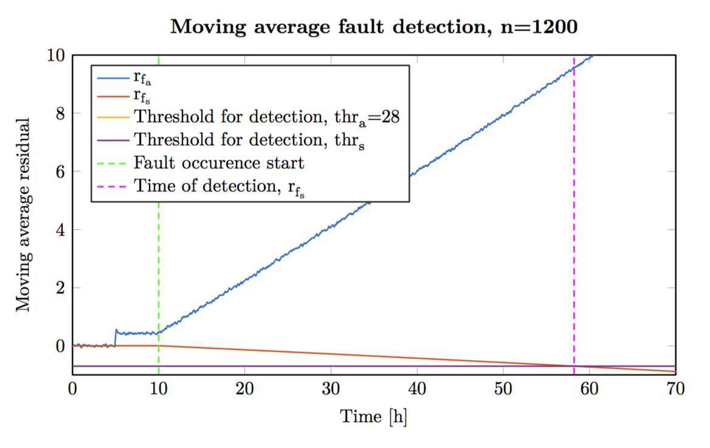
Fault Detection and Isolation
Filtered residual with an incipient sensor fault. Time of detection 58,2 hours.
Both residuals react

Slide 31
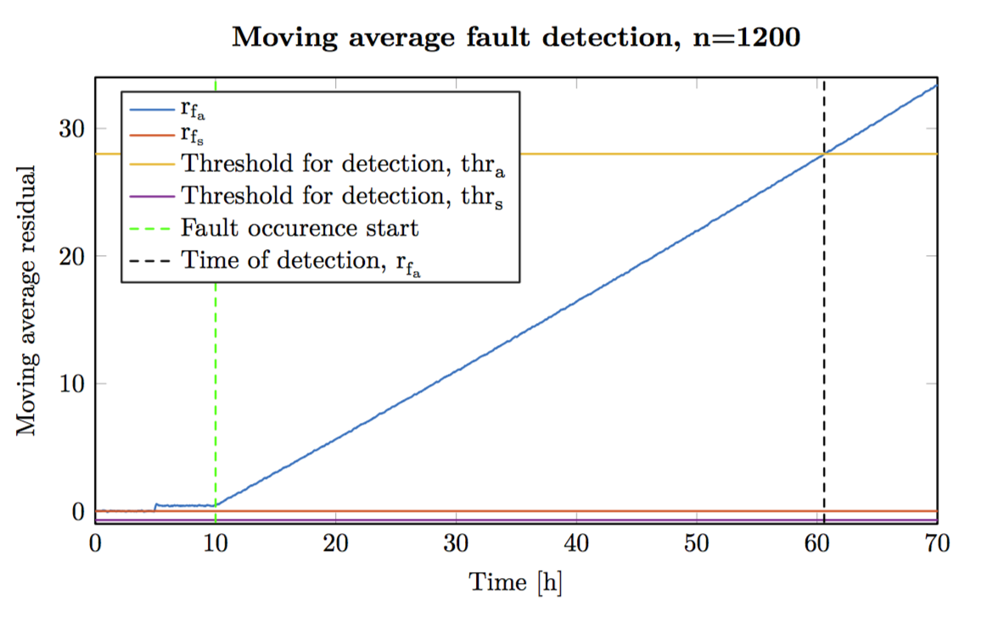
Fault Detection and Isolation
Filtered residual with an incipient actuator fault. Time of detection 60,6 hours
Only one residual reacts, as the other one is decoupled

Slide 32
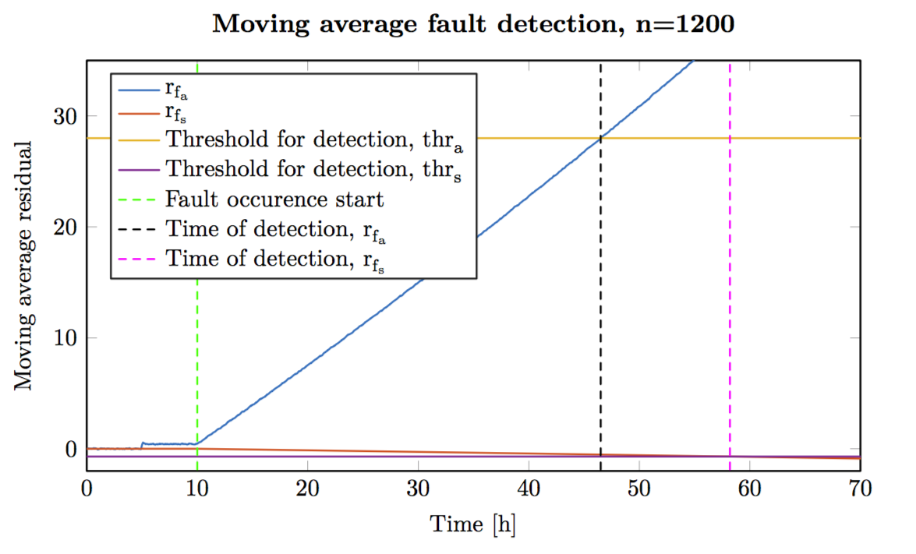
Fault Detection and Isolation
Filtered residual with an incipient actuator and sensor fault
The actuator fault is now determined at 46,5 hours, before it was at 60,6 hours

Slide 33
Conclusions
A fault detection analysis has been carried out, given the standard sensors of an OL boiler.
Two faults have been found to be able to detect and isolated
Oil flow sensor
Oil system I/P converter
Two methods of closed loop identification have been used
Hansen Scheme
Direct identification with MATLAB linear grey box: steepest descent and auto search method
Fault detection scheme, unknown input observer.
One observer decouples from actuator fault
One observer sensible to both faults
Possible to isolate both faults by moving average filtering
Adaptive fault detection scheme has been successfully developed, which is deemed possible to implement on the real setup.

Slide 34
Future Work
The direct closed loop identification shows promising results, however it should be tested in a real set up
Unknown input observer has been used to detect the faults. There exist methods to make a robust residual generation
A decision method based in an adaptive threshold should be developed, such that the it works in more than one operating points.
The real plant is nonlinear, a nonlinear unknown input observer could be designed, however, this requires nonlinear system identification

